Slide 1
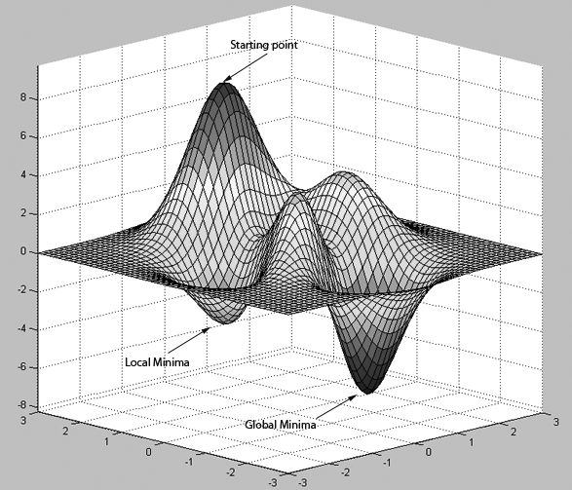
An error surface
.

Slide 2
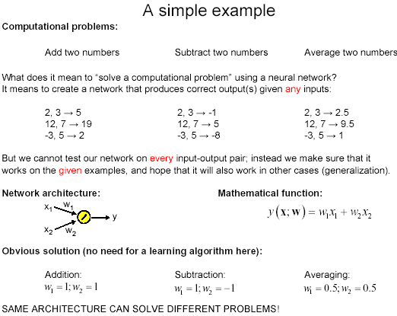

Slide 3
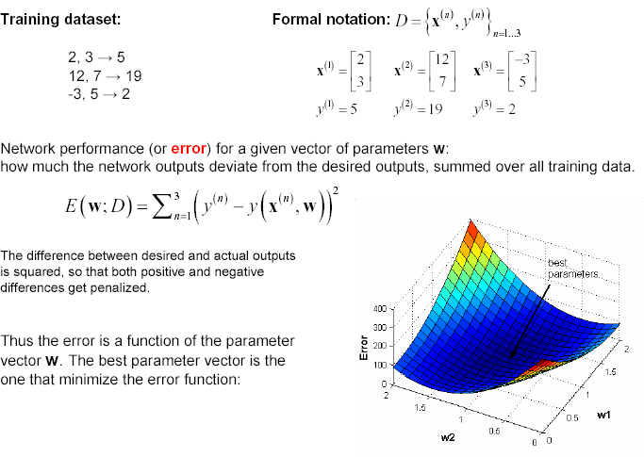
ERROR SURFACE

Slide 4
X= [2 3; 12 7; -3 5];
y = [5 19 2];
w1 = 0:0.1:2;
w2 = 0:0.1:2;
for p1 = 1:length(w1)
for p2 = 1:length(w2)
err(p1,p2) = 0;
for n = 1:3
% compute network output for example n
ynet = w1(p1)*X(n,1) + w2(p2)*X(n,2);
% update total error
err(p1,p2) = err(p1,p2) + (y(n) - ynet)^2;
end;
end;
end;
% plot error function
surf(w1,w2,err);

Slide 5


Learning by Error Minimization
We like to minimize the squared error (which is a function of the weights), for each training pair/pattern:
Square makes error positive and penalizes large errors
1/2 just makes some of the maths easier
The total error will be the sum of errors across all patterns
Need to change the weights in order to minimize the error
– Use principle of gradient descent - Calculate derivative (gradient) of the error with respect to the weights, and then change the weights by a small increment in the opposite direction to the gradient

Slide 6
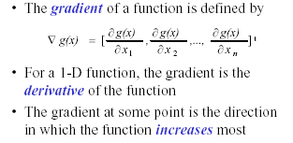
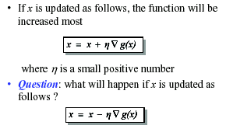
The gradient Descent Optimization
Direction of steepest descent

Slide 7
The components of the gradient vector are
d = t

Slide 8
Example 2
x₁
2
0
4
-3.93
d = t
x₂
1
The transfer function is unipolar continuous (logsig)
net=2*0.982+4*0.5-3.93*1=0.034
o=1/(1+exp(-0.04)) = 0.51
Error=1-0.51=0.49
4+0.1*0.1225*.5=4.0061
-3.93+.1*.1225*1=-3.9178
net = 2.012*0.982+4.0061*0.5-3.9178*1=0.061
Error=1-0.5152=0.4848
o=1/(1+exp(-0.061)=0.5152

Slide 9
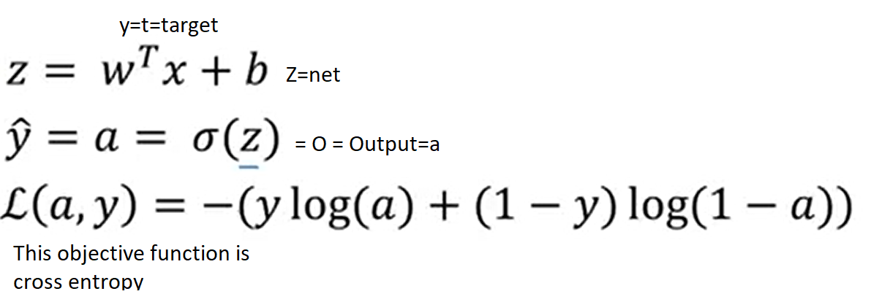
For logistic regression
Instead of mean squared error loss function, use cross entrpopy. Then only difference is the term (d-o) will change

